Slide 1
<<Project Title: AI-Based Smart Classroom Monitoring System for Student Attendance, Attentiveness, and Behavior Analysis >> (Date)
Department of Computer Science and Engineering
Course Name: Project Work Course Code: CSP81 Credits: 0:0:12 Term: Feb – June 2025
Presented by:
.
.
<usns> | <names>
Guided By:
<Guide name>
<Designation>

Slide 2
Agenda
1.Introduction
2.Problem Statement
3.Objectives
4.Literature Survey
5. Software requirement specifications
6. System design
7. Implementation
8. Testing
9. Results and Performance analysis
10. Conclusion and Future Work
11.References
12. Papers published

Slide 3
Introduction
Traditional classroom monitoring is manual and difficult to manage in large classes.
Artificial Intelligence can automatically analyze classroom activities using computer vision and data analytics.
AI systems help track attendance, student attention, and participation in real time.
Smart classroom monitoring improves teaching effectiveness and learning outcomes.

Slide 4
Problem statement
Monitoring student attendance, attentiveness, and classroom behavior manually is difficult and time-consuming, especially in large classrooms. Teachers cannot continuously observe all students during a lecture, which may lead to missed insights about student engagement and participation. Existing classroom monitoring methods lack automated mechanisms to analyze classroom activities effectively. Therefore, there is a need for an AI-based system that can automatically monitor and analyze classroom behavior, attendance, and engagement to support better teaching and learning outcomes.

Slide 5
Objectives
To develop an AI-based system for automatic classroom monitoring.
To detect and record student attendance using computer vision techniques.
To analyze student engagement and attentiveness during classroom sessions.
To generate reports and insights to help improve teaching and classroom management.

Slide 6
Literature survey
No. | Author / Year | Title of Paper | Method / Technique | Key Contribution
1 | Trabelsi et al., 2023 | Real-Time Attention Monitoring System for Classroom | Deep learning + computer vision | Developed a real-time system to monitor students’ emotions, attention, and attendance using vision-based analytics.
2 | Chen et al., 2023 | Student Behavior Detection Based on Improved YOLOv8 | YOLOv8 object detection | Proposed an improved YOLOv8 model for recognizing classroom behaviors such as writing, raising hands, and inattentiveness.
3 | Wang et al., 2023 | Classroom Behavior Detection with Deformable DETR and Swin Transformer | Transformer-based detection | Combined Swin Transformer and Deformable DETR to detect student actions and analyze classroom interactions.
4 | Jia et al., 2024 | Student Behavior Recognition in Classroom | YOLOv5 + OpenPose | Proposed a deep learning model combining YOLOv5 and pose estimation to detect student activities and engagement.
5 | Mahmood et al., 2024 | Measuring Student Engagement through Behavioral and Emotional Features | Deep learning | Developed a framework to analyze both emotional and behavioral engagement of students during lectures.

Slide 7
Software requirement specifications
Functional Requirements
The system should capture classroom video using cameras.
The system should automatically detect and mark student attendance.
The system should analyze student behavior and engagement during the lecture.
The system should generate reports on attendance and classroom activity.
Non-Functional Requirements
The system should process data in real time with high accuracy.
The system should ensure data privacy and security.
The system should be scalable for multiple classrooms.
The system should provide a user-friendly interface for teachers and administrators.

Slide 8
SRS Contd…
Hardware Requirements
Computer/Laptop with sufficient processing capability
CCTV or classroom camera
Internet connectivity
Storage device for saving data
Software Requirements
Operating System: Windows / Linux
Programming Language: Python
Libraries: OpenCV, TensorFlow / PyTorch
Database: MySQL / MongoDB
Development Tools: VS Code / Jupyter Notebook

Slide 9
Detailed Functional requirements
1. Classroom Video Capture
The system should capture real-time video from classroom cameras to monitor student activities during lectures. The captured video should be processed continuously for analysis.
2. Automatic Attendance Detection
The system should automatically detect and record student attendance using facial recognition or student identification methods. The attendance data should be stored in a database for future reference.
3. Student Behavior Detection
The system should identify and classify student behaviors such as listening, writing, raising hands, using mobile phones, or being inattentive using computer vision techniques.
4. Student Engagement Analysis
The system should analyze student engagement levels by detecting head pose, eye direction, or body posture to determine attentiveness during the lecture.

Slide 10
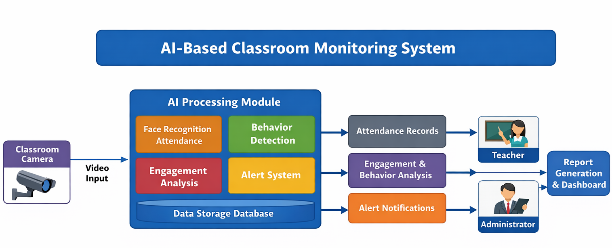
System design

Slide 11
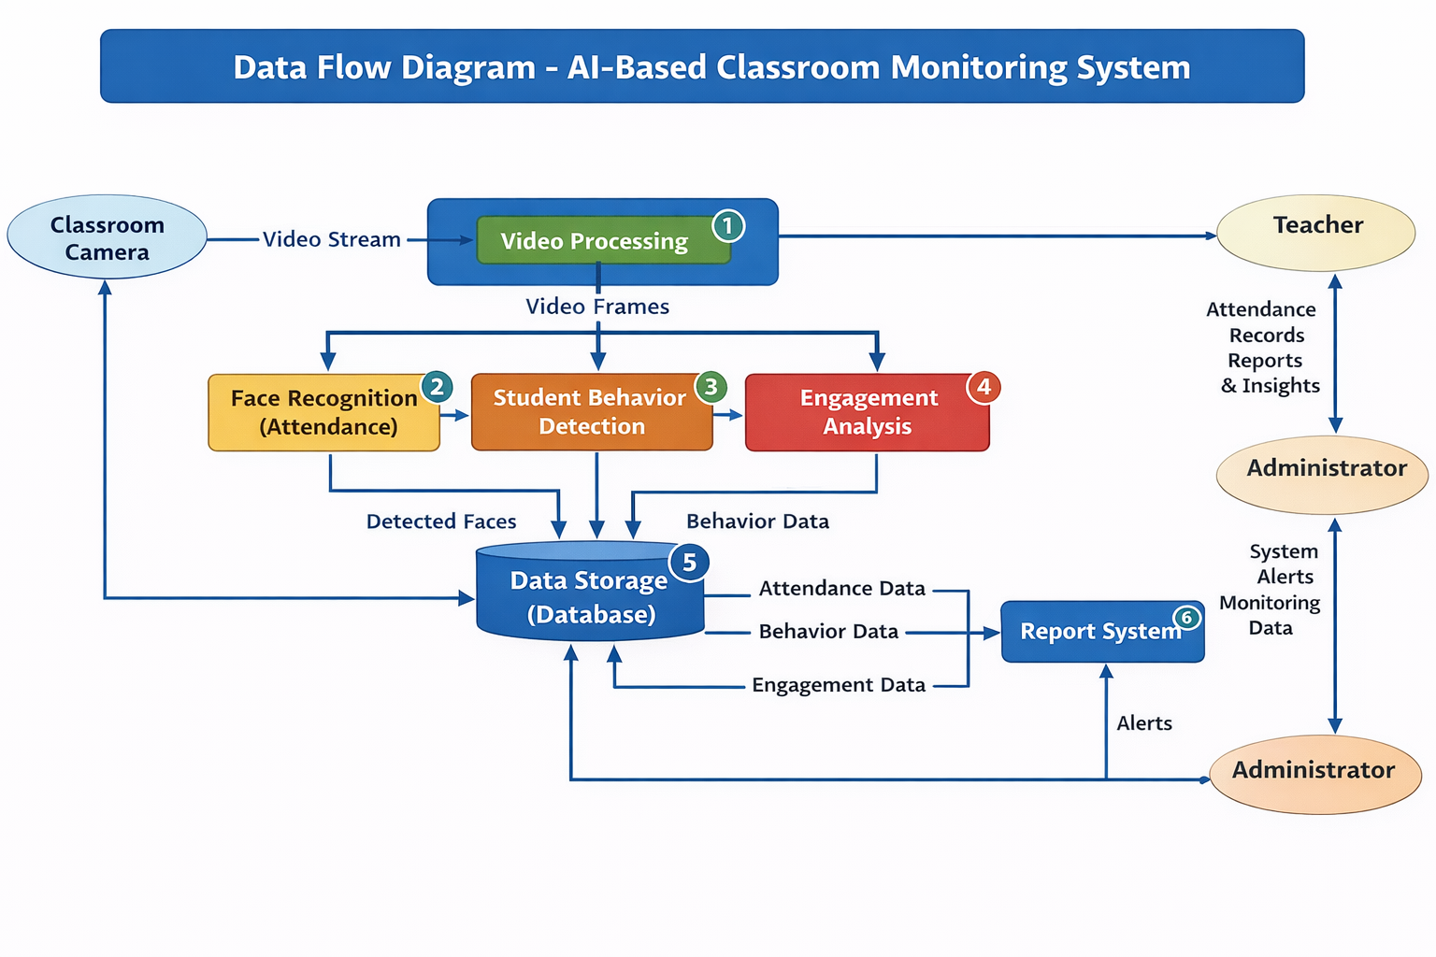
Data flow diagram

Slide 12
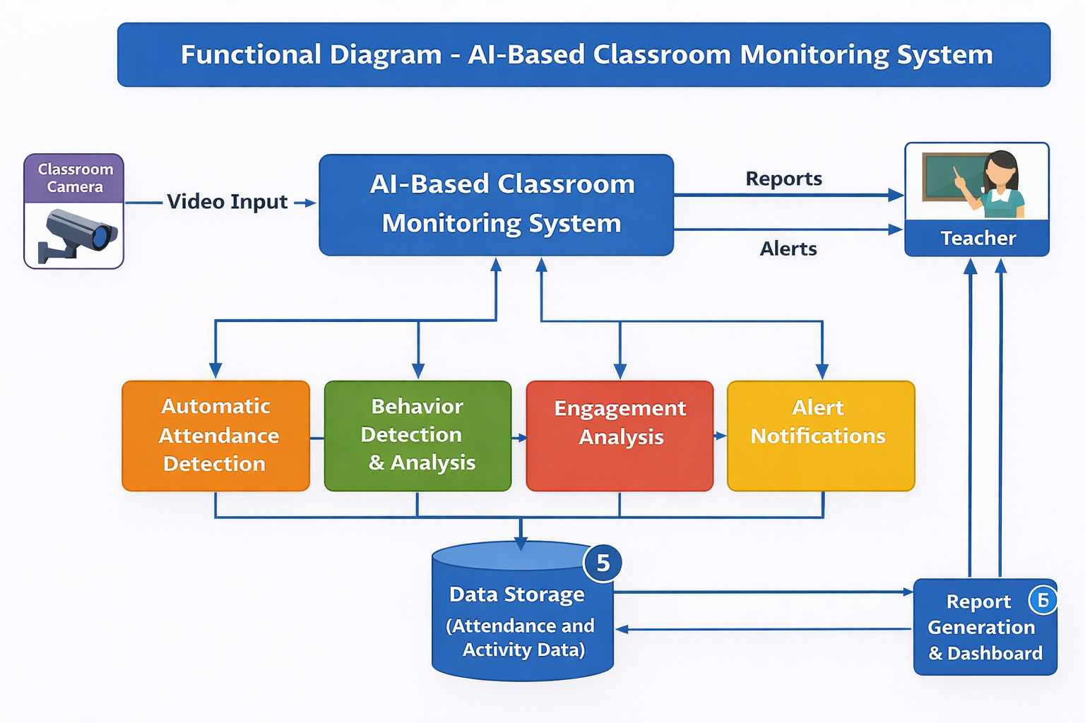
Functional diagram

Slide 13
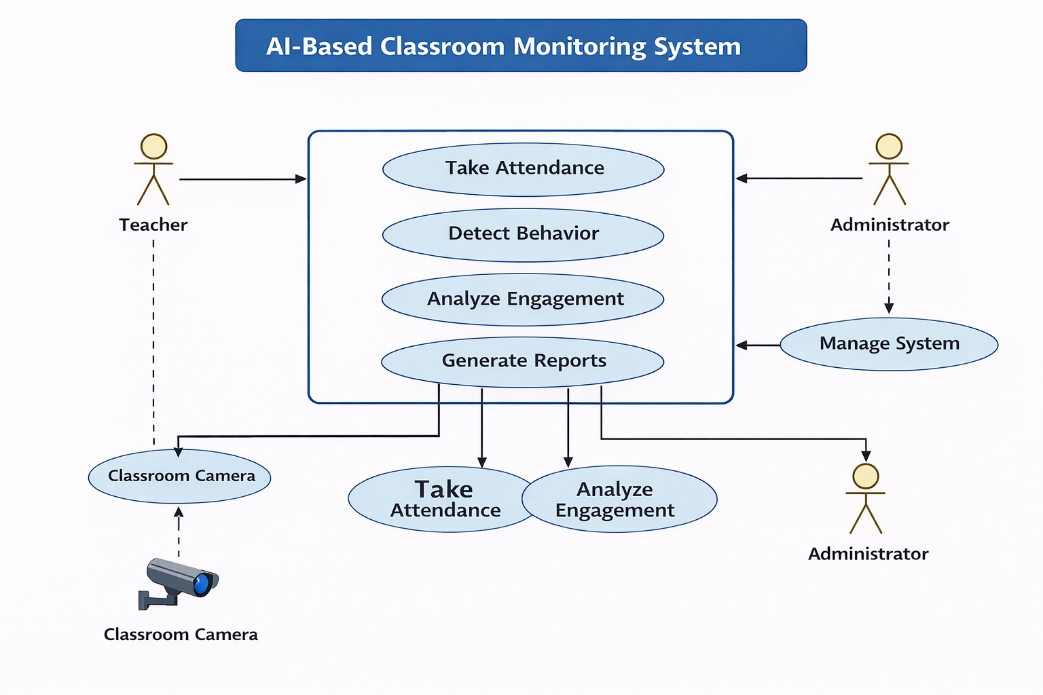
UML Diagram

Slide 14
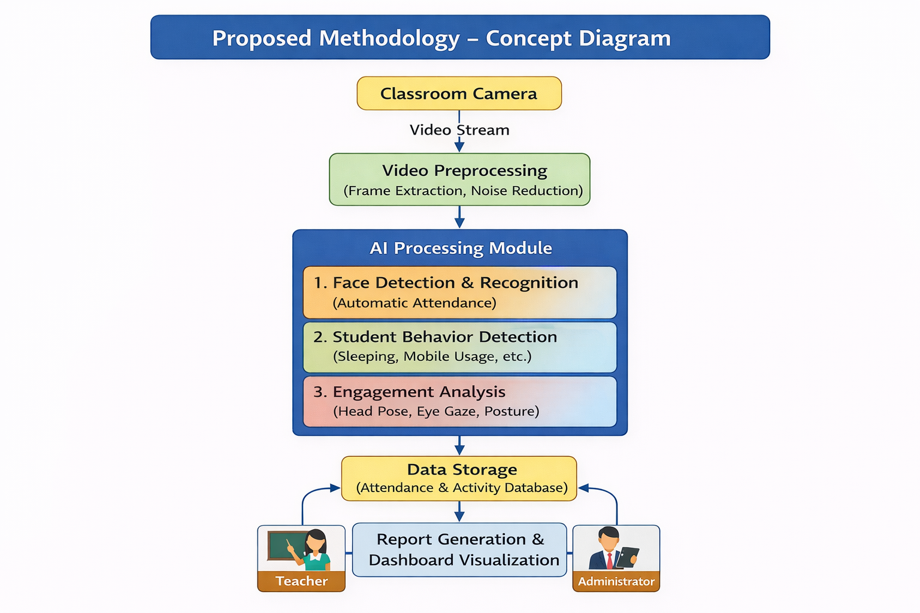

Slide 15
Implementation- Algorithm
1. Start
2. Initialize classroom camera
3. Capture real-time video stream
4. WHILE class session is active DO
5. Extract video frames from stream
6. Preprocess frame (resize, noise removal)
7. Detect faces in the frame
8. FOR each detected face DO
9. Recognize student using face recognition model
10. Mark attendance in database
11. END FOR
12. Detect student behaviors (writing, sleeping, mobile usage)
13. Analyze engagement using head pose / eye gaze detection
14. Store attendance and behavior data in database
15. END WHILE
16. Generate classroom monitoring report
17. Display report to teacher and administrator
18. Stop

Slide 16
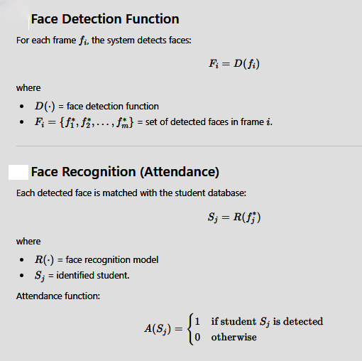
Mathematical Model

Slide 17
Show the Coding

Slide 18
Demo

Slide 19
Testing
Test Case ID | Module | Test Scenario | Input | Expected Output | Result
TC01 | Video Capture | Check whether camera captures live classroom video | Camera ON | Live video stream displayed | Pass/Fail
TC02 | Face Detection | Detect student faces from frame | Classroom image/video frame | All visible faces detected with bounding boxes | Pass/Fail
TC03 | Face Recognition | Recognize registered student | Known student face | Student name/ID displayed correctly | Pass/Fail
TC04 | Attendance Marking | Mark attendance for recognized student | Recognized student face | Attendance stored in database/file | Pass/Fail

Slide 20
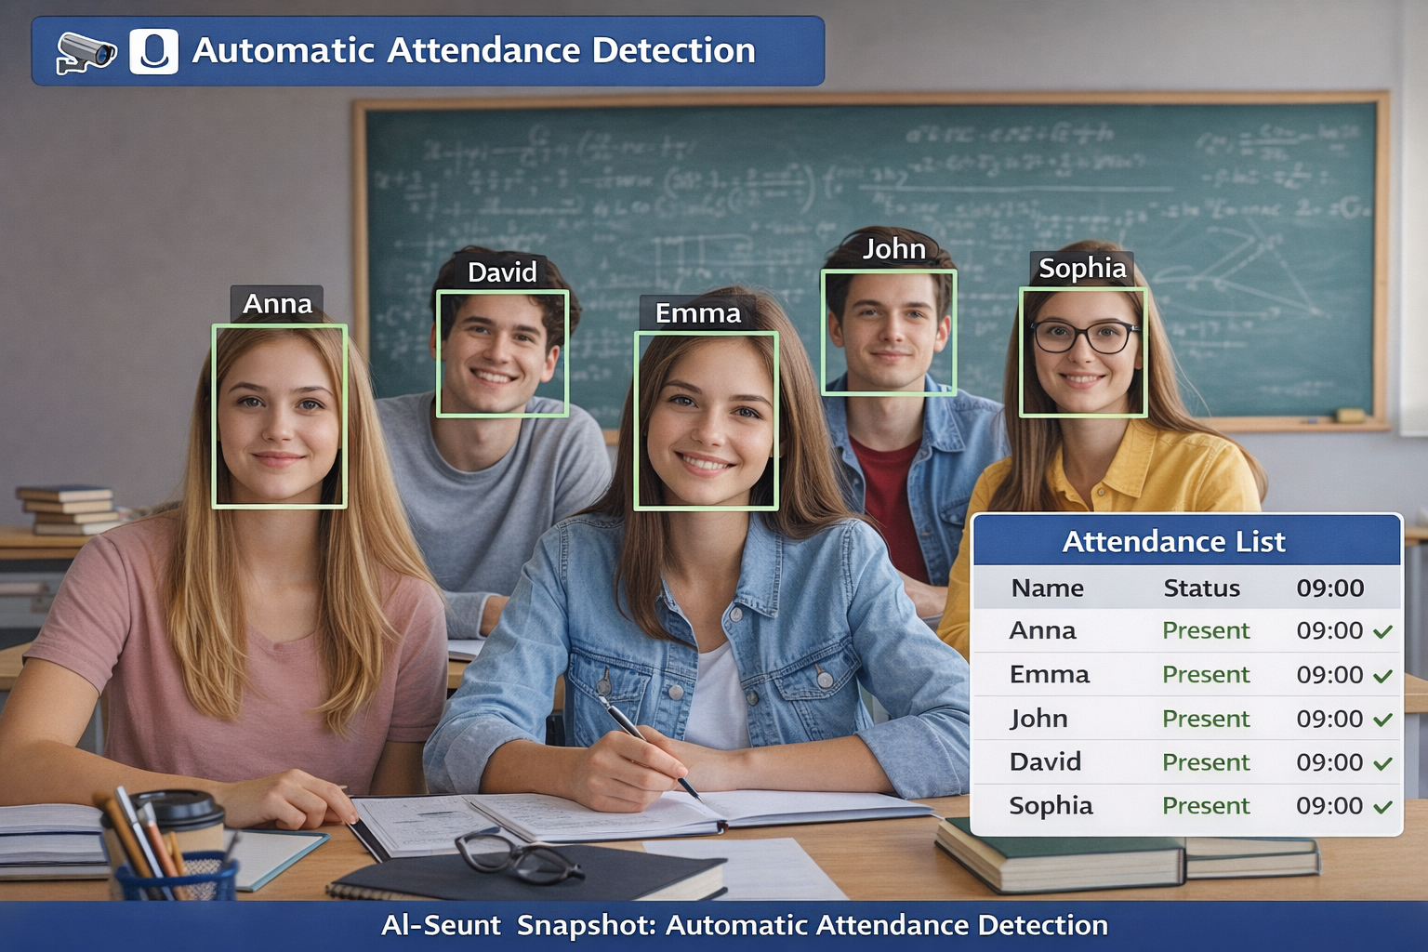
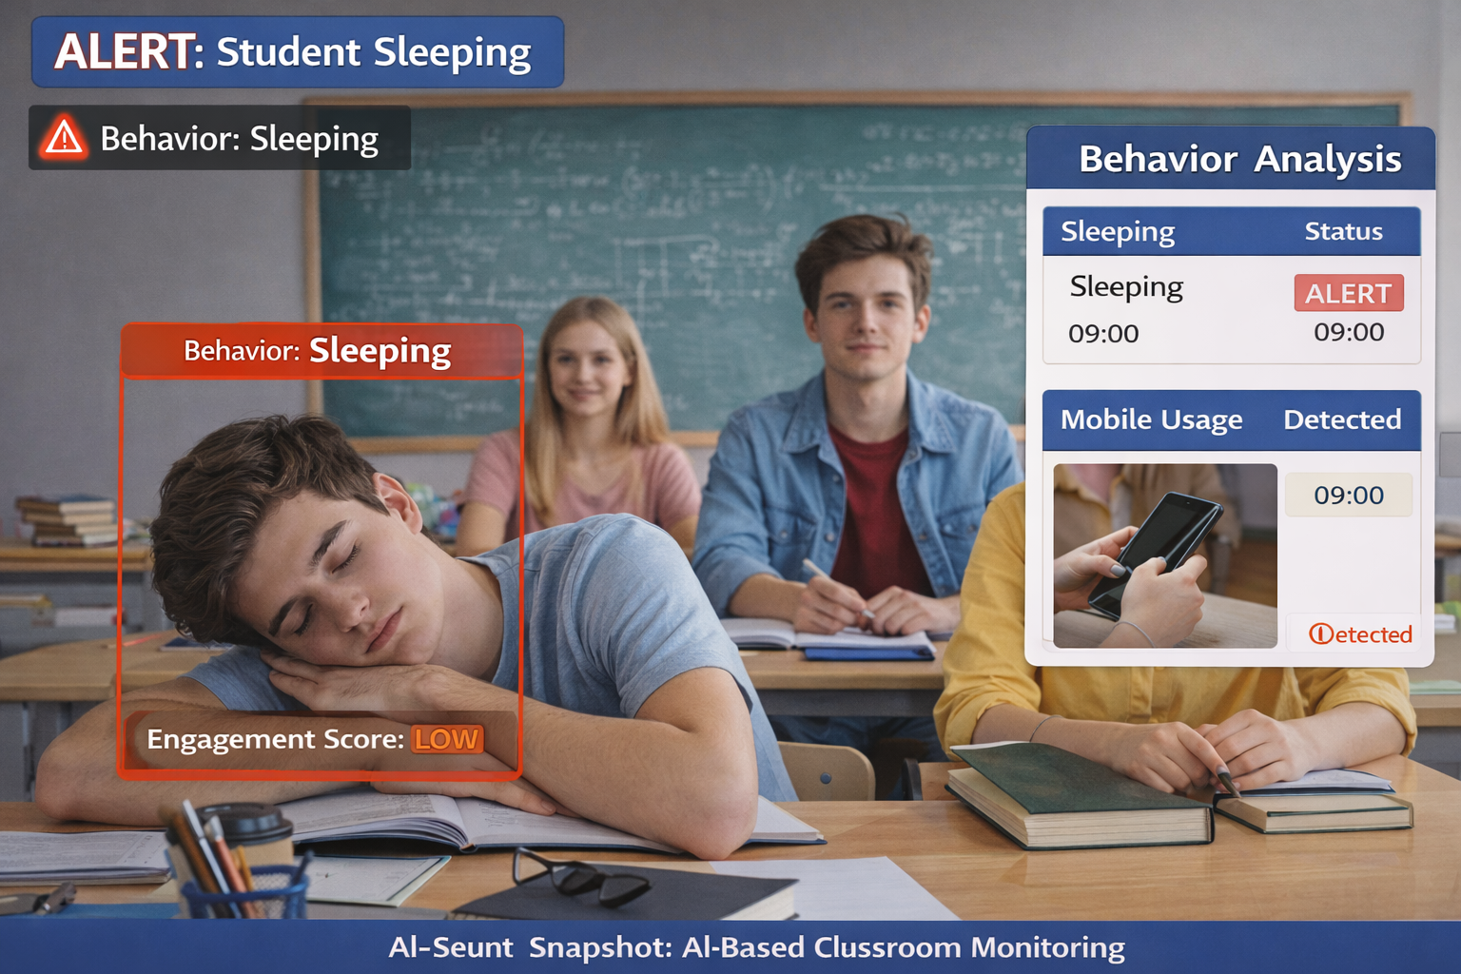
Results Snapshots

Slide 21
Performance Comparative Analysis with existing and proposed methods
Method | Attendance Accuracy (%) | Behavior Detection Accuracy (%) | Response Time (s)
Manual Monitoring | 70 | 60 | 10
Basic CCTV Monitoring | 80 | 68 | 8
Traditional ML-Based Monitoring | 88 | 82 | 5
Proposed AI-Based Monitoring | 96 | 94 | 2

Slide 22
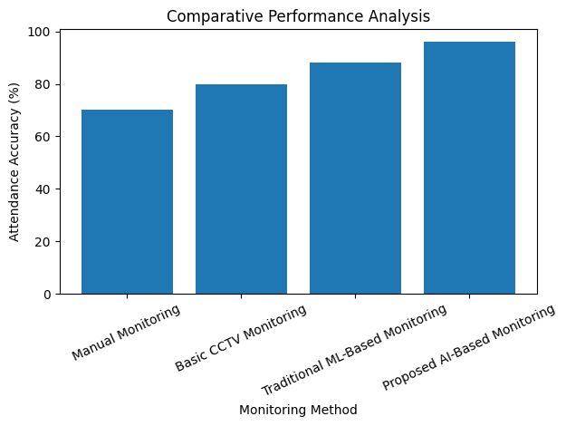

Slide 23
Conclusion and Future Scope
The proposed AI-based classroom monitoring system effectively automates attendance, behavior detection, and engagement analysis using computer vision techniques.
The system improves classroom management and monitoring accuracy compared to traditional manual methods.
Real-time analysis helps teachers obtain instant insights into student participation and attentiveness.
The proposed solution demonstrates efficient performance, faster response time, and improved monitoring capabilities.
Integration of advanced deep learning models to improve behavior and emotion recognition accuracy.
Development of multi-camera systems for monitoring large classrooms more effectively.
Incorporation of speech analysis and audio-based engagement detection.
Deployment as a cloud-based smart classroom analytics platform for large educational institutions.

Slide 24
References
Dalal, N., & Triggs, B. (2005). Histograms of oriented gradients for human detection. Proceedings of the IEEE Conference on Computer Vision and Pattern Recognition (CVPR), 886–893.
Redmon, J., Divvala, S., Girshick, R., & Farhadi, A. (2016). You only look once: Unified, real-time object detection. Proceedings of the IEEE Conference on Computer Vision and Pattern Recognition (CVPR), 779–788.
He, K., Zhang, X., Ren, S., & Sun, J. (2016). Deep residual learning for image recognition. Proceedings of the IEEE Conference on Computer Vision and Pattern Recognition (CVPR), 770–778.
Zhang, Z., Luo, P., Loy, C. C., & Tang, X. (2014). Facial landmark detection by deep multi-task learning. European Conference on Computer Vision (ECCV), 94–108.
Goodfellow, I., Bengio, Y., & Courville, A. (2016). Deep learning. MIT Press.
Howard, A. G., Zhu, M., Chen, B., Kalenichenko, D., Wang, W., Weyand, T., & Adam, H. (2017). MobileNets: Efficient convolutional neural networks for mobile vision applications. arXiv preprint arXiv:1704.04861.
Baltrusaitis, T., Robinson, P., & Morency, L. P. (2018). OpenFace: An open source facial behavior analysis toolkit. IEEE Winter Conference on Applications of Computer Vision, 1–10.
D’Mello, S., & Graesser, A. (2012). Dynamics of affective states during complex learning. Learning and Instruction, 22(2), 145–157.
Whitehill, J., Serpell, Z., Lin, Y. C., Foster, A., & Movellan, J. (2014). The faces of engagement: Automatic recognition of student engagement from facial expressions. IEEE Transactions on Affective Computing, 5(1), 86–98.
Chen, X., Zhang, H., & Li, Y. (2020). Deep learning-based student behavior recognition in classroom environments. IEEE Access, 8, 123984–123993.

Slide 25
Papers published
Parkavi A., Alex S.A., Pushpa Latha. “Deep Learning Based Classroom Management System for Student Behaviour Detection.” International Conference on Artificial Intelligence and Data Analytics (AIDA), 2024.
Parkavi A., Alex S.A., et al. “Drone Based Intelligent System for Monitoring Social Distancing Using YOLOv5 and YOLOv6.” International Conference on Computational Intelligence and Communication Technologies (CICT), 2024.

Slide 26
1.Introduction
2.Problem Statement
3.Objectives
4.Literature Survey –
(put it in tabular form(title , author , year,technique used , result,discussion / future scope/ adv & dis ( only very recent papers(2024,2025))
5.Software Requirement Specifications
(H/W,S/W required)
6. System design
(HLD - general architecture diagram ,Data flow diagram , functional diagram. LLD- UML diagrams, Proposed Methodology/Approach / Solution
Concept Diagram : ( Clear detailed schematic / block diagram / flow chart depicting the proposed concept / solution )
7.Implementation
( pseudocode/algorithms /mathematical model//code snippets of different modules/demo)
8.Testing
(test cases)
9. Results & Performance analysis
(snapshots, comparative & efficiency analysis in table, graph, formats)
10.Concusion and Future work
11.References
(APA style)
12. Published paper

